Slide 1
Spectroscopy of the The Superluminous Supernova ASASSN 15ua
Danielle Dickinson
Dr. Nathan Smith
Dr. Jennifer Andrews
Arizona Space Grant Consortium Symposium
April 18

Slide 2
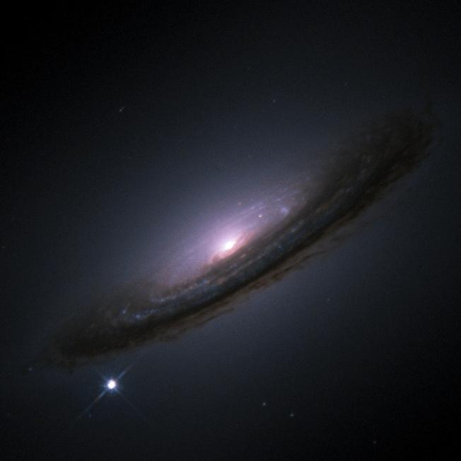
Type Ia
NASA/ESA

Slide 3
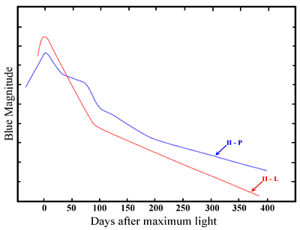
Type Ia
Type II P/L
NASA/ESA
astronomy.swin.edu.au

Slide 4
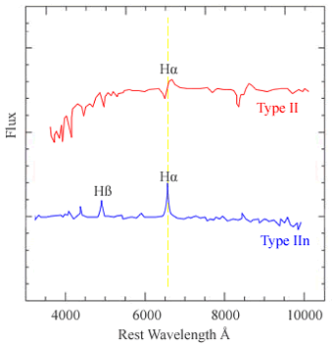
Type Ia
Type II P/L
Type IIn
NASA/ESA
astronomy.swin.edu.au
astronomy.swin.edu.au

Slide 5
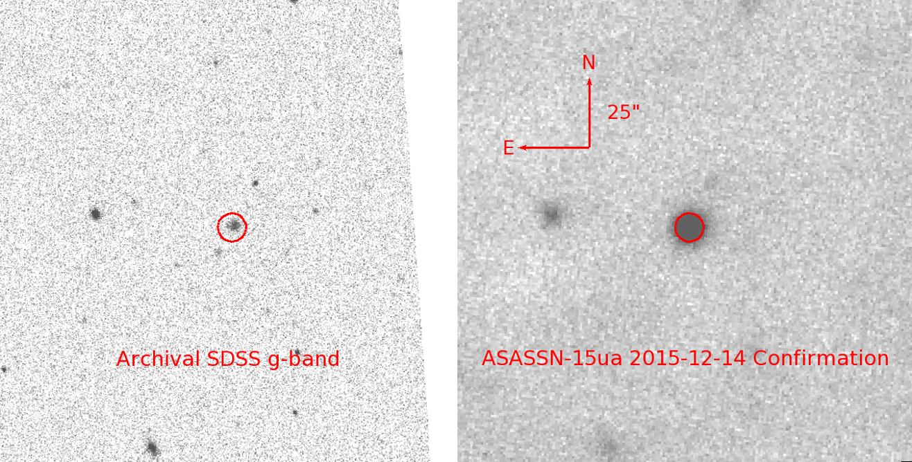
On December 12, 2015...
astronomy.ohio-state.edu

Slide 6
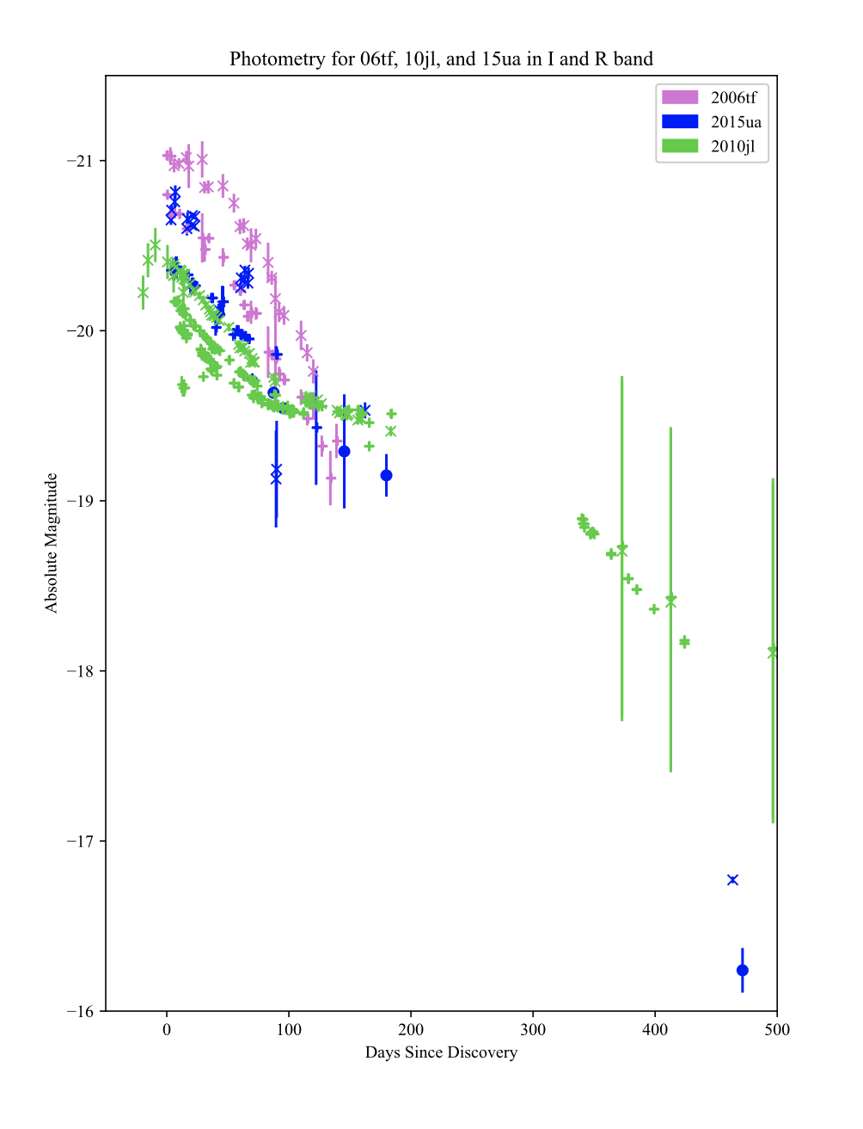
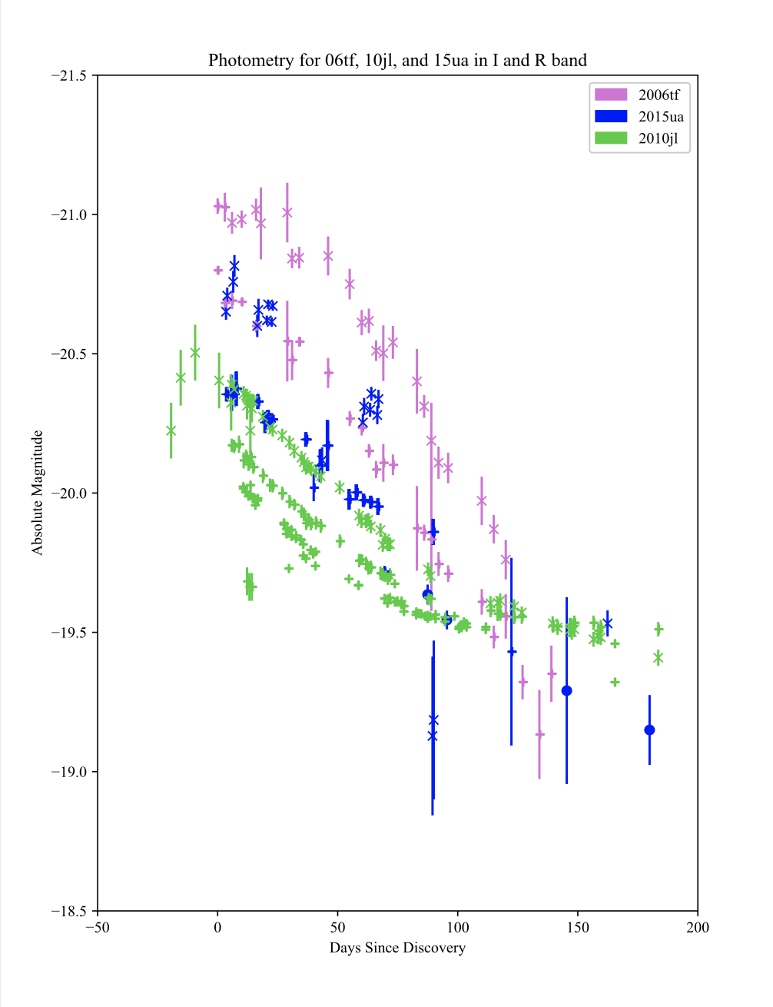
ASASSN 15ua radiated 4.34E50 erg of energy!

Slide 7
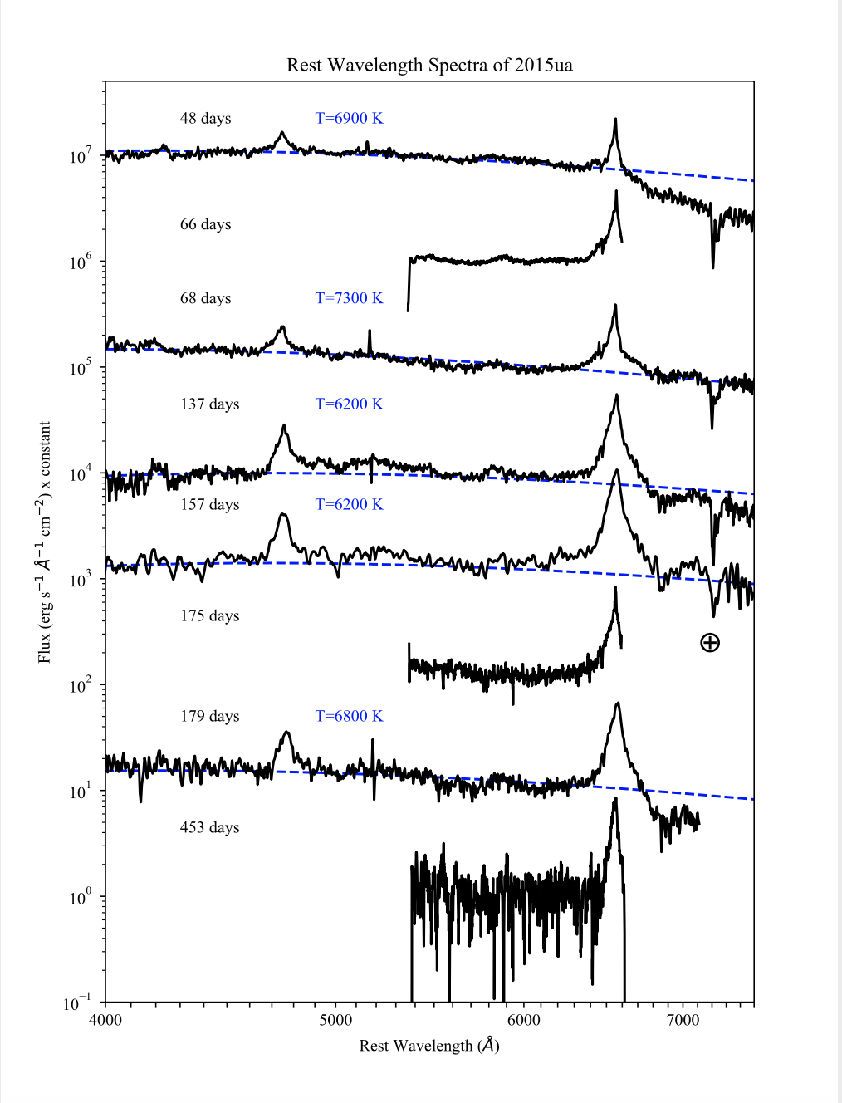

Slide 8
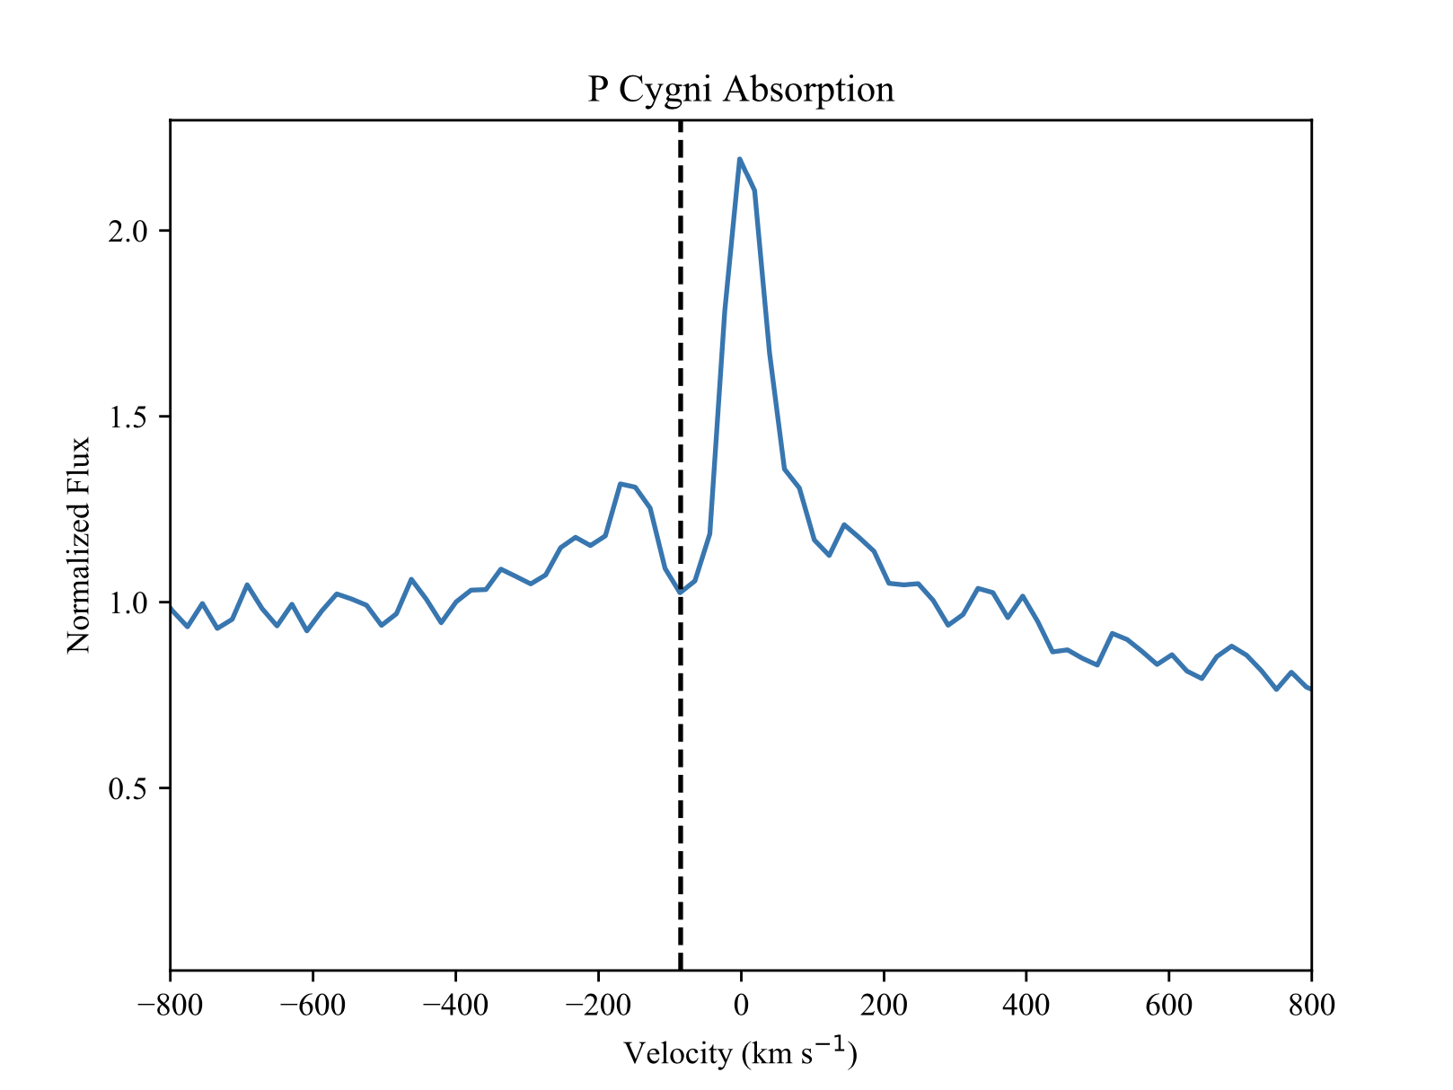
85km/s

Slide 9
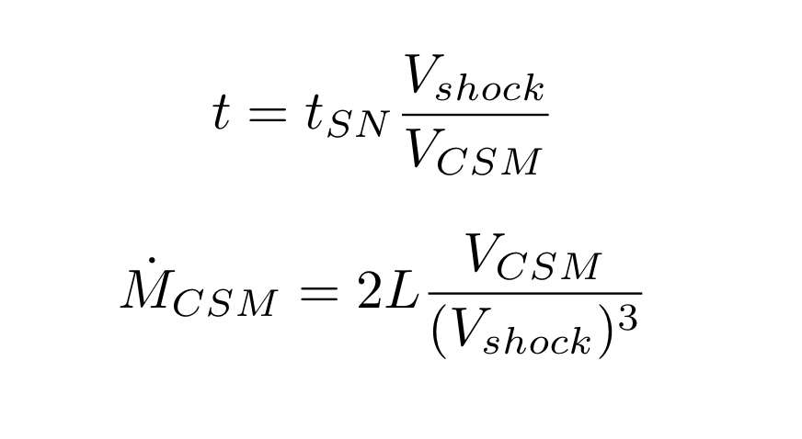
t=11.5 years
VCSM=85 km/s
Vshell=2000 km/s
Mass Loss Rate= 1 Solar Mass/Year

Slide 10
Thank You!

Slide 11
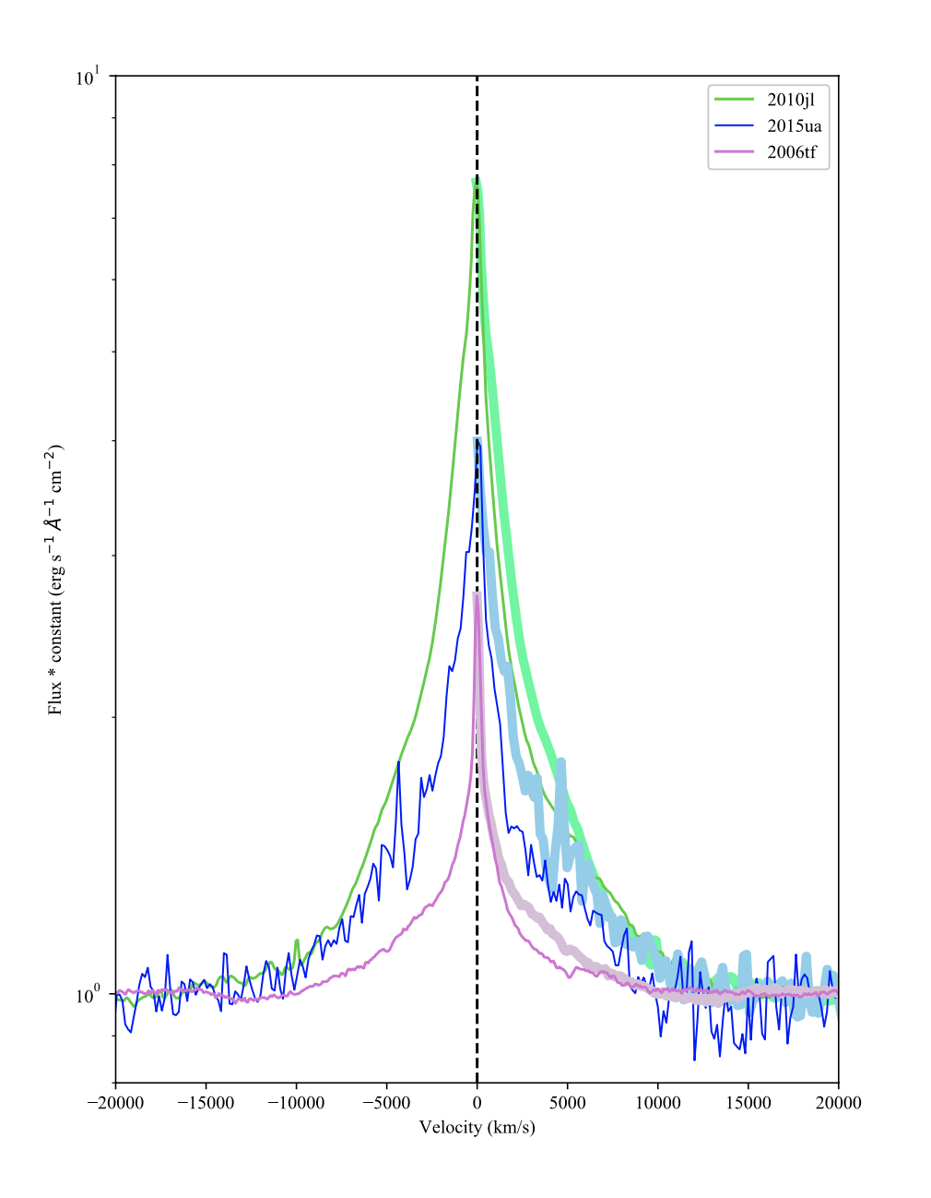
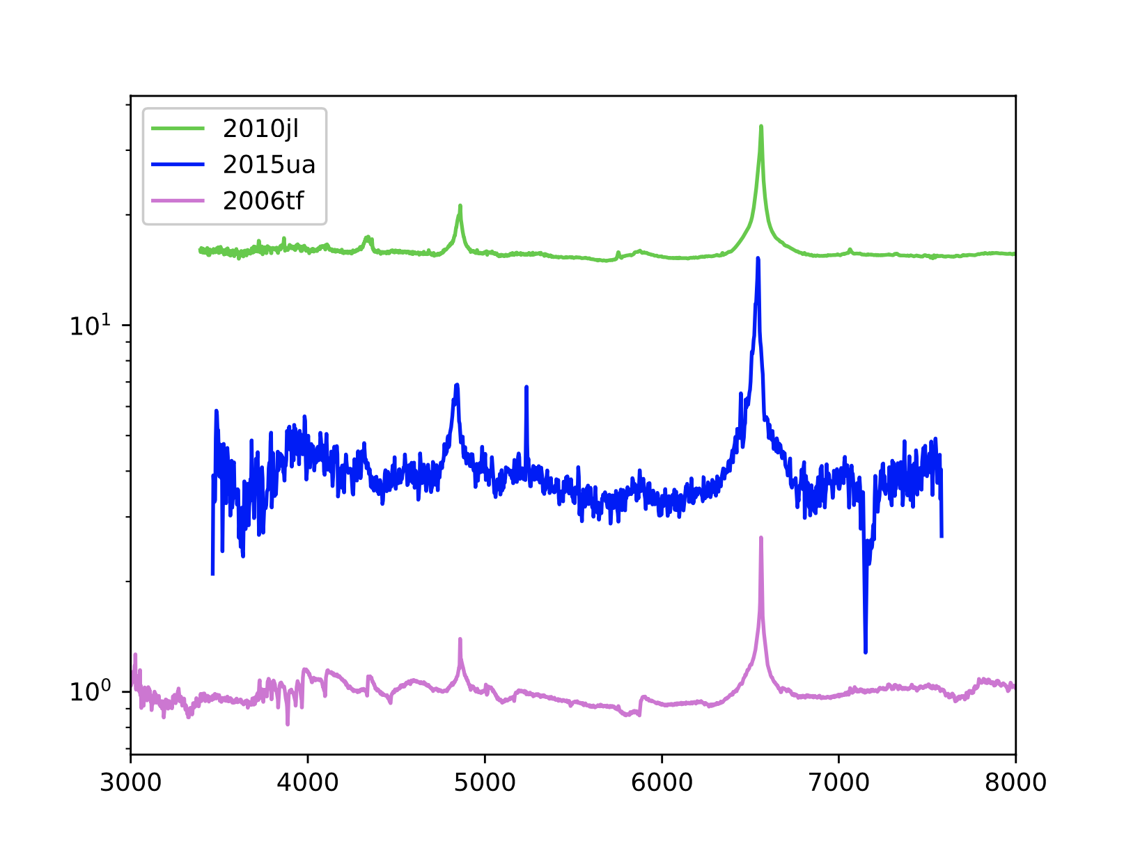

Slide 12
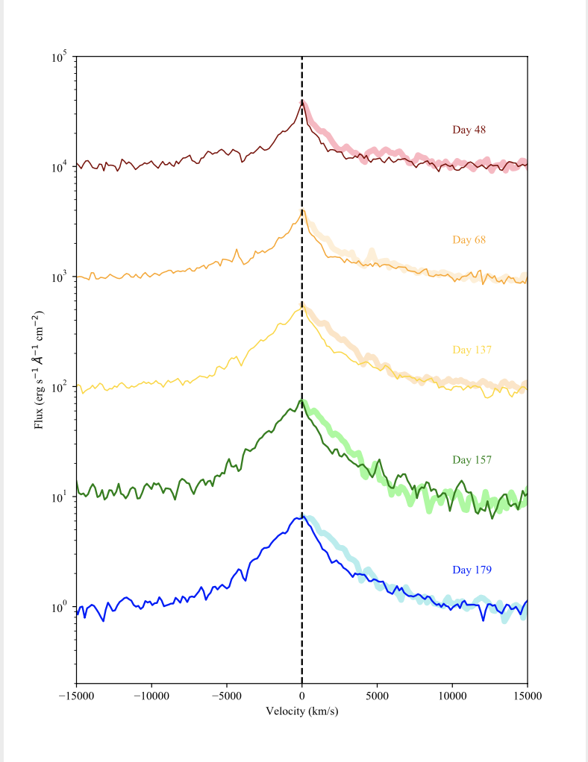
Reflected Spectra

